Slide 1
Windows admin password recovery

Slide 2
Reset Forgotten Admin Password on Windows 10 with Windows Password Reset Tool
The PassFab 4WinKey is software exclusively designed to help you resolve all the password related problems on your PC. This software is a complete package that not only lets you reset the passwords but also create/delete the accounts and remove the password from any account in simple steps. If you want to use this incredible tool to reset admin password Windows 10, download it here and use it as follows:
Download, install and launch PassFab 4WinKey on any PC.
Plug in the USB drive and choose it from the list. Click Next.
Let the instructions burn on the drive and plug it out once completed.
Plug the USB drive into the locked PC and restart it. And press the boot key to enter the Boot menu.
Set your USB device on priority and press F10 to save settings. And choose the Windows system and click Next.
Choose the account for which you want to reset the password. Meantime, choose the Reset Account Password option from the list and click Next.
Enter the new password and click Reset.

Slide 4
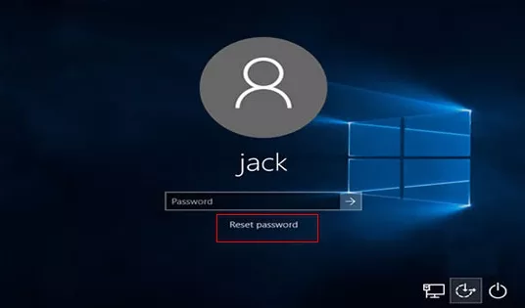
Reset Administrator Password Windows 10 Via Password Reset Disk
Password reset disk is another one of the simplest ways that you can follow if you forgot admin password Windows 10. You do not need to install the third-party tools, but a pre-created password reset disk to follow this method.
If you have a password reset disk, here is how to reset admin password on Windows 10:
Plug-in the password reset disk.
On the login screen, enter any random password and press Enter.
A Reset password link will appear. Click on it.

Slide 5
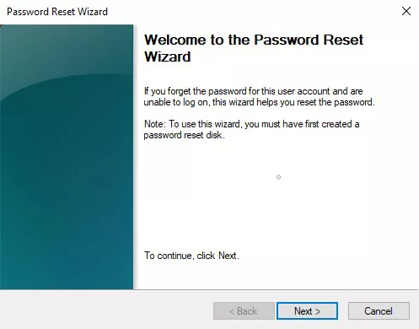
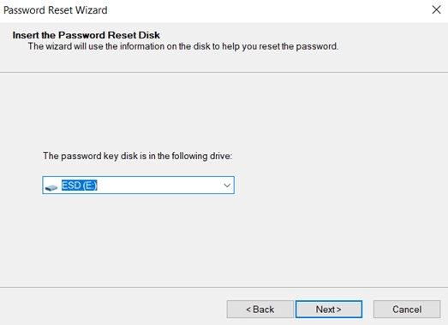
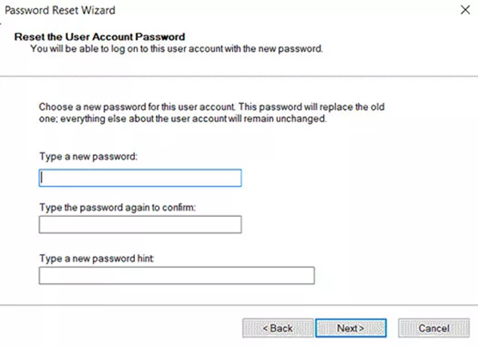
4. When the Password Reset Wizard appears, click Next.
5. Choose your password reset disk from the options and click Next.
6. Enter the new password, confirm it and Click Next.
7. Click Finish to complete the process.

Slide 6
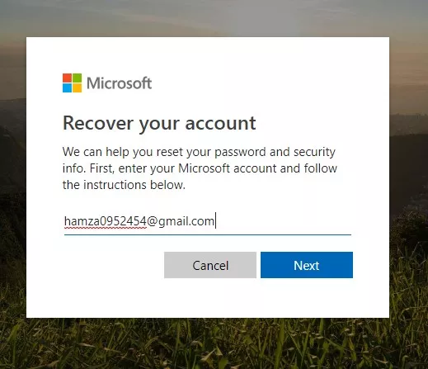
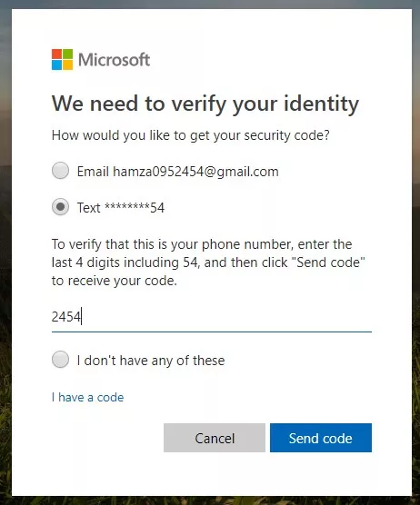
Reset Windows 10 Forgotten Admin Password Online
The recent Windows versions allow you to integrate your local user accounts to the online Microsoft account that you can use to log into your PC. The Microsoft account makes your PC more secure as it requires some validations. If you had linked the Microsoft account to the Admin account, you could use it to reset your Windows account password as follows:
Open the browser on any other PC and go to account.live.com
Enter your Email or the phone number that you set on your locked account.
Verify your details.
Enter the new password.
Re-enter the new password and click Next to reset the password.

Slide 7
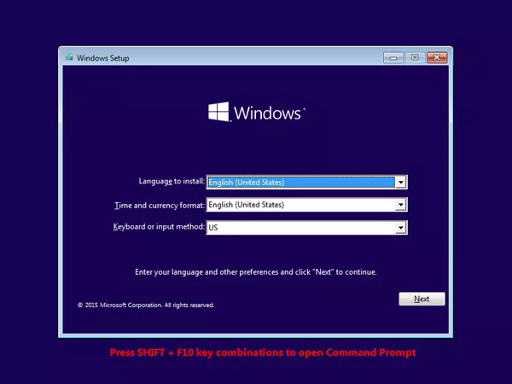
Reset Windows 10 Local Admin Password via CMD
To change the admin account password from the command prompt, you need Windows installation media.
Boot your computer via Windows Installation Media.
Press Shift + F10 simultaneously when you see the following screen:

Slide 8
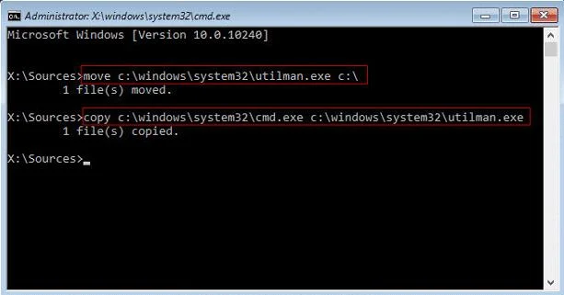
3. When the Command Prompt Window appears, type the following command, replacing the C:/ with the drive your Windows is installed in. Press Enter.
move C:\windows\system32\Utilman.exe c:\
4. Again, type the following command and press Enter afterwards:
Copy C:\windows\system32\cmd.exe c:\windows\system32\utilman.exe
5. Remove the installation media and Reboot your PC by typing wpeutil reboot. Press Enter.
6. Plug in the bootable drive and let your system boot from the system memory.

Slide 9
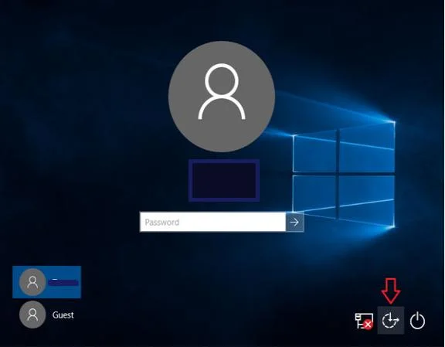
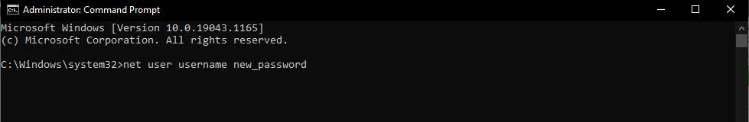
7. When the login screen appears, click on the Ease of Access Center icon.
You will see the Command Prompt Window.
8. Type the password reset command and press Enter.
Enter the username and new password to reset the password.
net user "username" "password"
9. Reboot your PC once again.

